Slide 1


The Ideal Work Environment: What factors impact Attrition and Employee Satisfaction?
DDSAnalytics

Slide 2

Key Questions and Insights
Identify Key Factors for Employee Attrition
Conduct an Exploratory Analysis to Identify Key Relationships between Attributes
Construct a Classification Model for Employee Attrition
Construct a Regression Model to Predict Monthly Revenue

Slide 3
Attrition Why do Employees Quit?

Slide 4
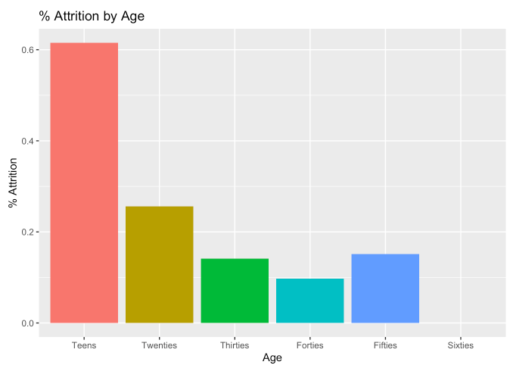
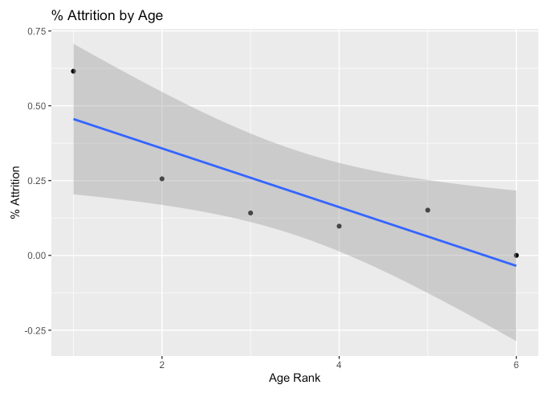
Factor 1: Age

Slide 5

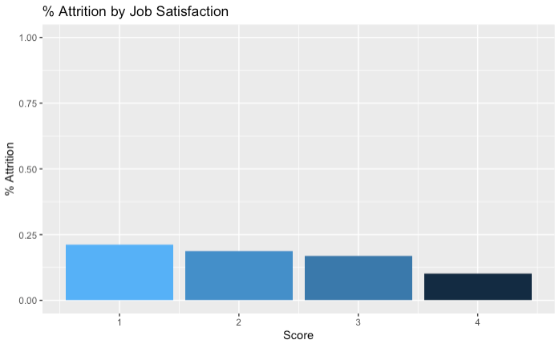
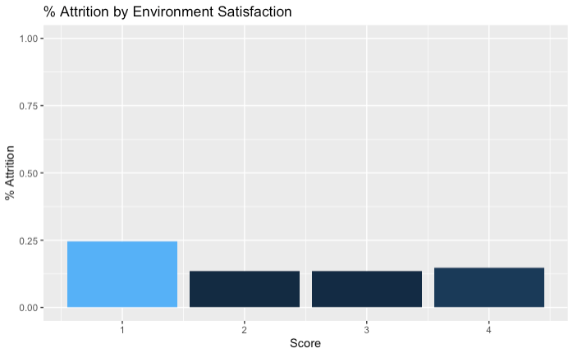
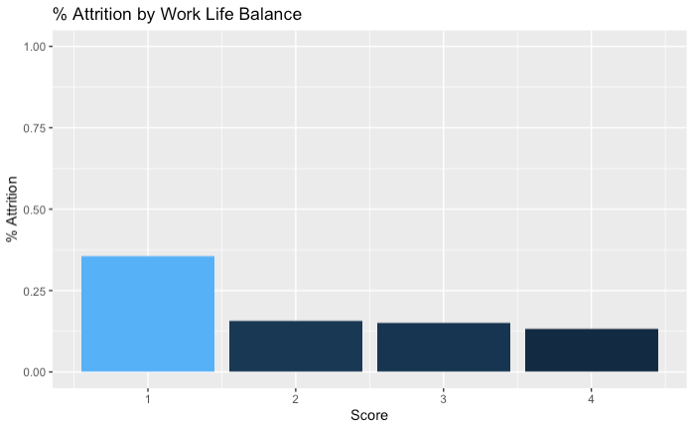
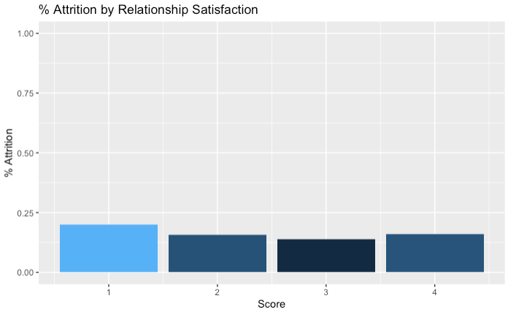

Slide 6
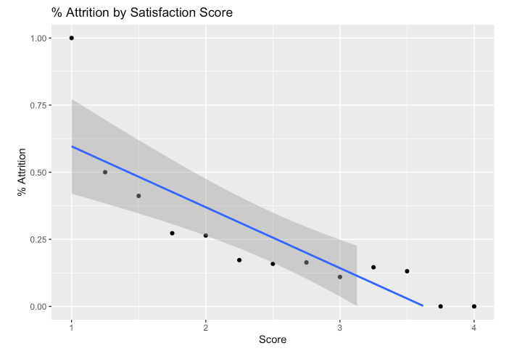
Factor 2: Satisfaction Score

Slide 7

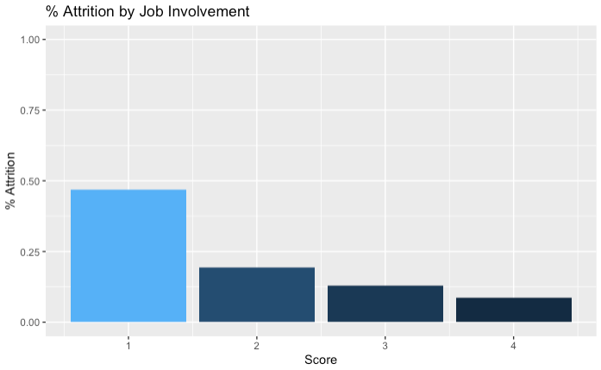
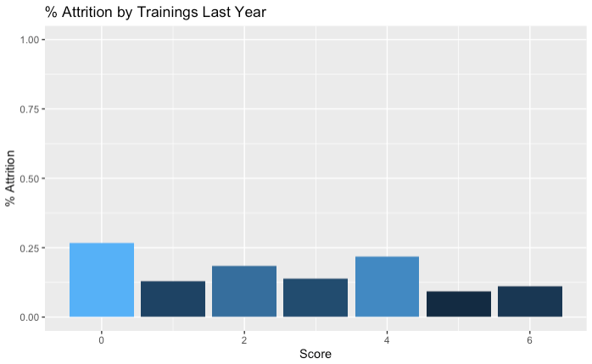
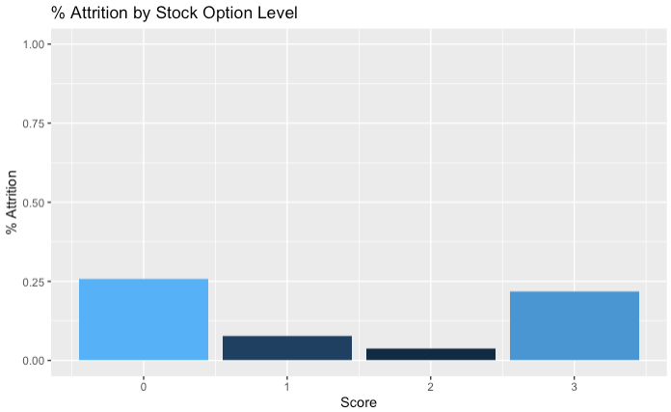

Slide 8
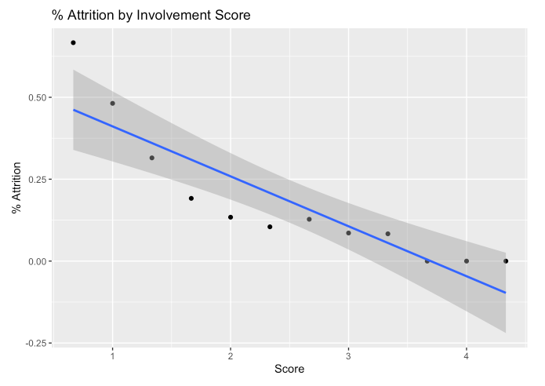
Factor 3: Involvement Score

Slide 9
Key Relationships What does the data tell us?

Slide 10
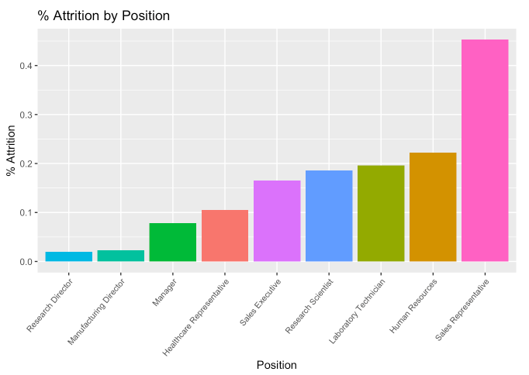
Highest Attrition Rate: Sales Representatives

Slide 11
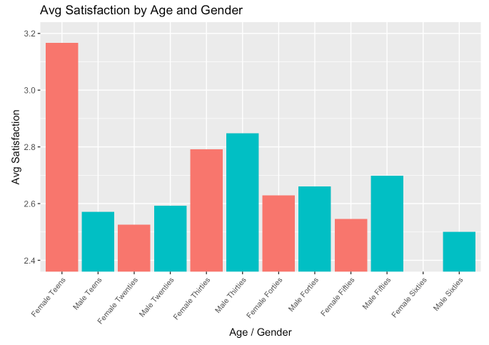
Satisfaction and Attrition Trends: Demographics

Slide 12
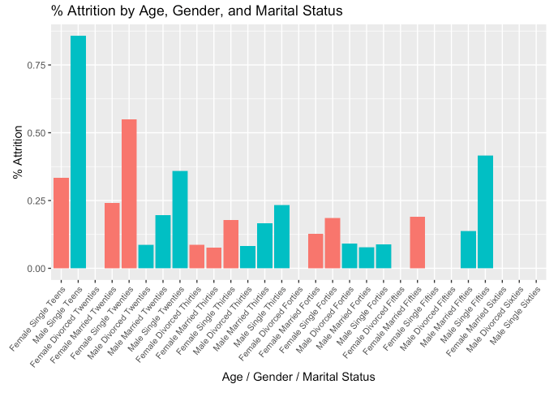
Satisfaction and Attrition Trends: Demographics

Slide 13
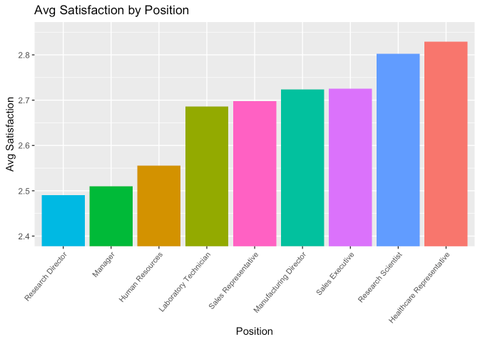
Employee Satisfaction: Job Title

Slide 14
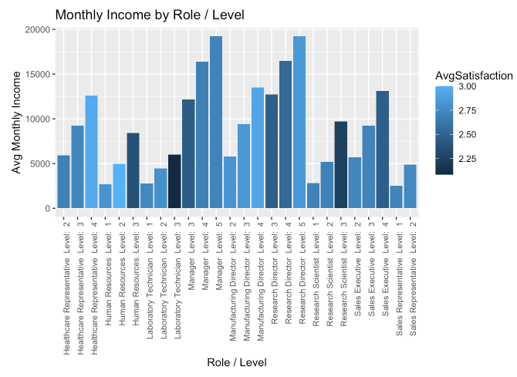
Employee Satisfaction: Job Title, Level, and Income

Slide 15
Classification Model What factors predict attrition?

Slide 16
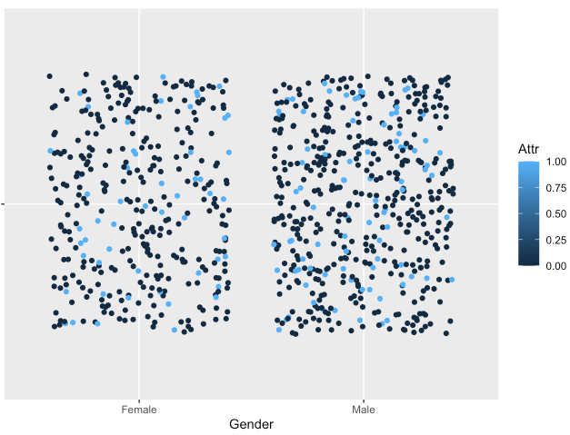
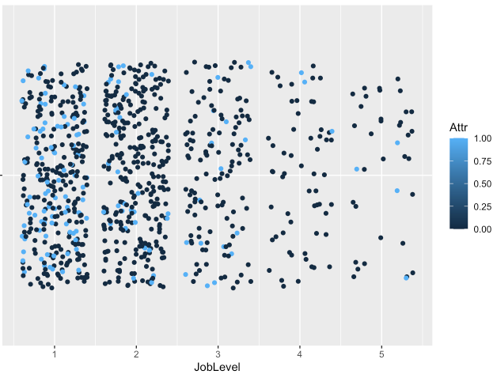
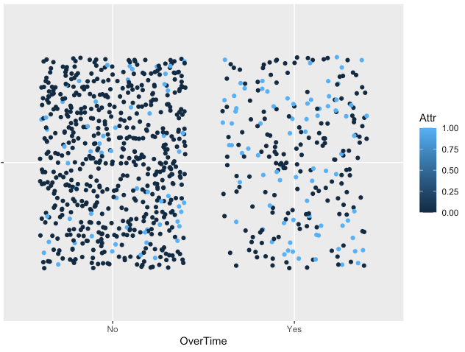
kNN Model

Slide 17
Naïve Bayes Model
Approach:
“Given the available data, what is the chance that a given employee is in the attrition group?”
Accuracy: 83.45%
Sensitivity: 87.53%
Specificity: 62.14%
Significantly better than kNN Model!

Slide 18
Regression Model How can we predict income?

Slide 19
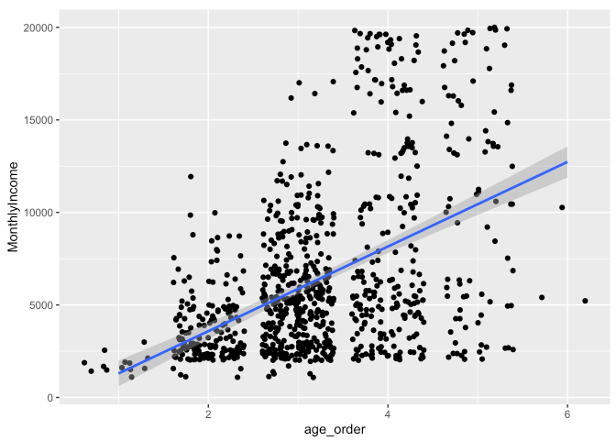
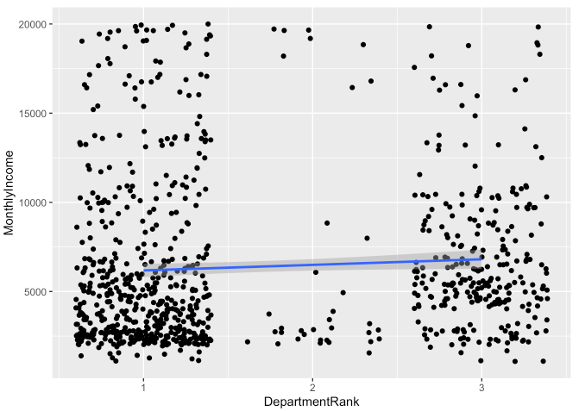
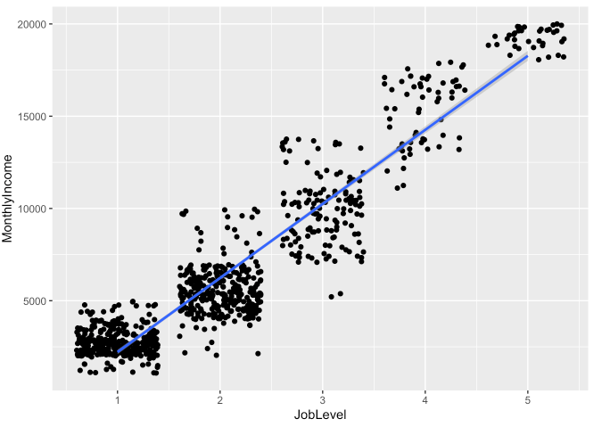
Linear Regression Model

Slide 20
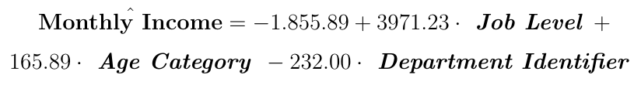
Linear Regression Model
Key Predictor Variables
Department
Age
Department
Model
RMSE = $1386.75
Measure of the concentration of the data around our regression model - The smaller, the better!

Slide 21
Questions?

